Slide 1
Trusted Agent Training
Privileged and Confidential
Do not copy, distribute, or reproduce in any media format without the express written permission of MedAllies, Inc.

Slide 2
Who Should Attend This Training?
The Trusted Agent for the Provider Organization must attend the Trusted Agent Training, as well as any designated Optional Alternate Trusted Agents
Additional individuals may attend:
Human Resources
Credentialing Department
C-level Executives
IT
HIM
Operations
Notes:
Training is required per contract

Slide 3
Learning Objectives:
By the end of this training, the Trusted Agent will be able to:
Understand the basics of what Direct is, including public key infrastructure (PKI) security principles and operations
Define the terms: Health Information Service Provider (HISP), Registration Authority (RA), Certificate Authority (CA), and Trusted Agent (TA)
Understand the roles and responsibilities of the Trusted Agent

Slide 4
Agenda
Trusted Agent and Identity Proofing
What is a Trusted Agent?
Why do I Need a Trusted Agent?
Direct Network and HISPs
Direct Accreditation Bodies
EHNAC
DirectTrust
HISP Operations
Registration Authority
Certificate Authority
Message Delivery and Security
Trusted Agent Responsibilities
Oversee: Gather, Verify, Report, Maintain Documentation
Additional Information

Slide 5
Trusted Agent and Identity Proofing

Slide 6
What is a Trusted Agent?
Trusted Agent ensures provider’s identity is verified prior to provider being able to communicate electronically
Identity Proofing (ID Proofing) is verifying a person is who they claim to be
Collection of identity verification documentation
A Trusted Agent is one method of identity proofing
Notes:
-Trusted Agent ensures provider’s identity is verified prior to provider being able to communicate electronically
-This will include the collection of identity verification documentation and the use of Trusted Agent

Slide 7
Identity Proofing
The Trusted Agent is responsible for ensuring that Identity Proofing processes and procedures are in place
If your organization collects I-9 Forms or verifies Medicare enrollment for staff members who will be receiving Direct Accounts, your identity proofing processes and procedures are already in place!

Slide 8
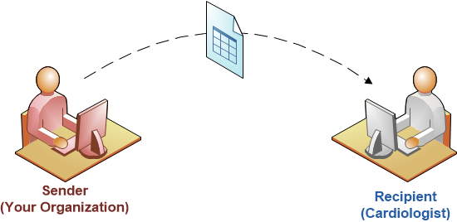
Why do I need a Trusted Agent?
You’re sending PHI to the Cardiologist you are referring to electronically…
How do you know that the Cardiologist you’re sending to is who they say they are?

Slide 9
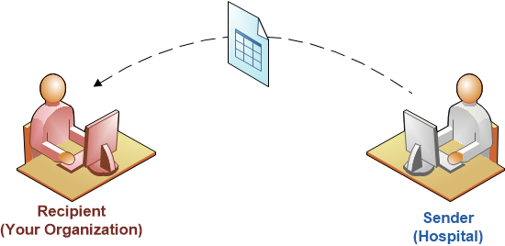
Why do I need a Trusted Agent?
You’re receiving PHI from the Hospital at patient discharge electronically…
How do you know that you can trust that the PHI came from a legitimate hospital employee?

Slide 10
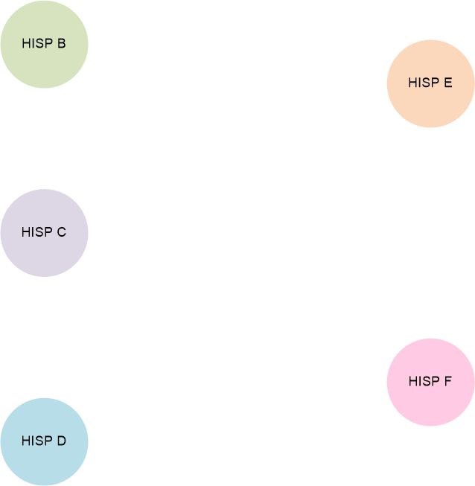
Electronic PHI Exchange: Direct Network
Health Information Service Provider (HISP) = The mechanism used to provision users with a universal, Direct Address following the Direct Project Standards
Notes:
Health Information Service Provider (HISP) = The mechanism used to provision users with a universal, Direct email address following the Direct Project Standards

Slide 11
How do you know which HISPs are safe to communicate with?
?

Slide 12
Direct Accreditation Bodies

Slide 13
Direct Accreditation Bodies
EHNAC (Electronic Healthcare Network Accreditation Commission) provides accreditation to HISPs
Similar to Joint Commission Accreditation
DirectTrust bundles accredited HISPs for connectivity to one another

Slide 14
EHNAC
Security
Identity Proofing
Notes:
Accredited HISPs share digital certificates with one another
Transparent and Efficient
Direct relying parties know whom to trust without having to engage in one-off contracts or single-use connections

Slide 15
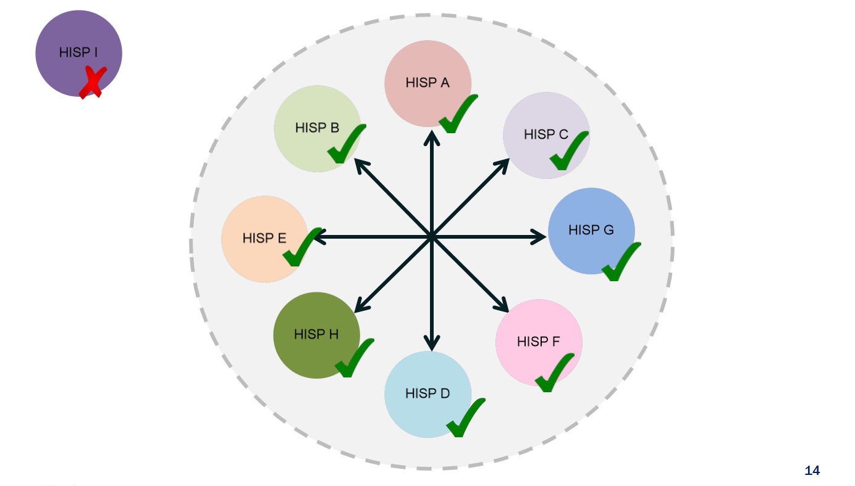
DirectTrust
?
Notes:
Accredited HISPs share digital certificates with one another
Transparent and Efficient
Direct relying parties know whom to trust without having to engage in one-off contracts or single-use connections

Slide 16
Electronic Healthcare Network Accreditation Commission
EHNAC ensures HISPs enforce:
Identity proofing of end users
Security of message transport
MedAllies is an EHNAC Accredited HISP
Accreditation process ~ 6 months
Notes:
HISPs and end users meet minimum requirements of identity proofing and security
Security of all healthcare transactions (i.e. Clearinghouses) to make sure data is transferred securely
The x.509 certificate policy is the set of rules surround the Digital certificates

Slide 17
EHNAC Accreditation Programs
DTAAP (HISP,CA, RA) Direct Trust Agent Accreditation Programs
OSAP Outsourced Services Accreditation Programs
ePAP ePrescribing Accreditation Programs
FSAP Financial Services Accreditation Programs
HIEAP Health Information Exchange Accreditation Program
HNAP Healthcare Network Accreditation Programs
ACOAP Accountable Care Organization Accreditation Program
PMSAP Practice Management Systems Accreditation Program
MSOAP Management Service Organization Accreditation Program
Serving Organizations Across the Healthcare Spectrum
Notes:
Keeping on that vein, MedAllies is accredited through EHNAC under the Direct Trust Agent Accreditation Program (DTAAP). This provides MedAllies with the ability to provide the following Services:
Health Information Service Provider (HISP) = The mechanism used to provision users with a universal, Direct email address following the Direct Project Standards
Certificate Authority (CA) = An entity that provide digital certificates to issue allowing those users to be certified to exchange messages following the Direct Project Standards
Registration Authority (RA) = An entity that verifies a certificate requestor’s identity and authorization either directly or through a Trusted Agent.
Trusted Agents (TAs) = An agent authorized by the Registration Authority and bound by the RA’s policies to act as proxy for verifying a certificate requestor’s identity and authorization.
As you can see, these services together allow MedAllies the ability to take an entity in the health related field and onboard them to be able to exchange Direct messages, verifying, authorizing, and certifying everything along the way.

Slide 18
DirectTrust
Responsible for security and interoperability of Direct per ONC (Office of the National Coordinator for Health Information Technology)
Sets policies and standards for electronic exchange via Direct
Policies: X.509 Certificate policy
Security: EHNAC accreditation
Notes:
Non-profit trade alliance
Advances secure health information exchange
The x.509 certificate policy is the set of rules surround the Digital certificates
MedAllies is heavily involved in DirectTrust
CEO is Chair of DirectTrust
Principal Architect is co-chair of Direct Directory Workgroup
CMO is co-chair of Transition of Care Workgroup

Slide 19
HISP Operations

Slide 20
Direct Address
A provider needs a Direct Address to send and receive Direct Messages through the HISP
To activate a Direct Address, one must:
Be registered on the HISP
Have a Certificate
Registration Authority (RA) must register the Direct Address
Certificate Authority (CA) must issue the Certificate

Slide 21
Registration Authority (RA) and Certificate Authority (CA)
Registration Authority (MedAllies, EHNAC accredited)
Enrolls Providers in the Direct network
Ensures Applicants have been identity proofed and notifies CA
Certificate Authority (MedAllies, EHNAC accredited)
Issues digital certificate for identity proofed Applicants
Guarantees the individual granted the unique certificate is who they claim to be

Slide 22
What Role does the Trusted Agent Play in this?
The Trusted Agent (TA) is an extension of the RA
Works on behalf of the RA to ensure identity proofing processes and procedures are in place
Has obligation of providing deliverables to RA

Slide 23
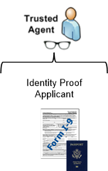
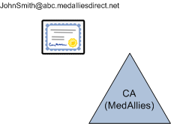
HISP involvement in Direct message delivery and security
MedAllies
Provider Organization
Step 1:
Dr. John Smith’s EHR connects to the MedAllies HISP
Step 2:
The Trusted Agent ensures that Dr. John Smith is identity proofed, then sends his information to MedAllies (RA)
Step 3:
MedAllies (RA) registers Dr. John Smith’s Direct Address and notifies the CA
Step 4:
MedAllies (CA) generates a certificate for Dr. John Smith’s Direct Address and sends to the HISP for configuration

Slide 24
Certificates
Certificates are used to secure messages during transmission between HISPs
Made up of a public / private key pair
Senders use the public key to lock message
The receiving HISP uses the recipient’s private key to unlock message
For more information on certificates see: DirectTrust Community X.509 Certificate Policy

Slide 25
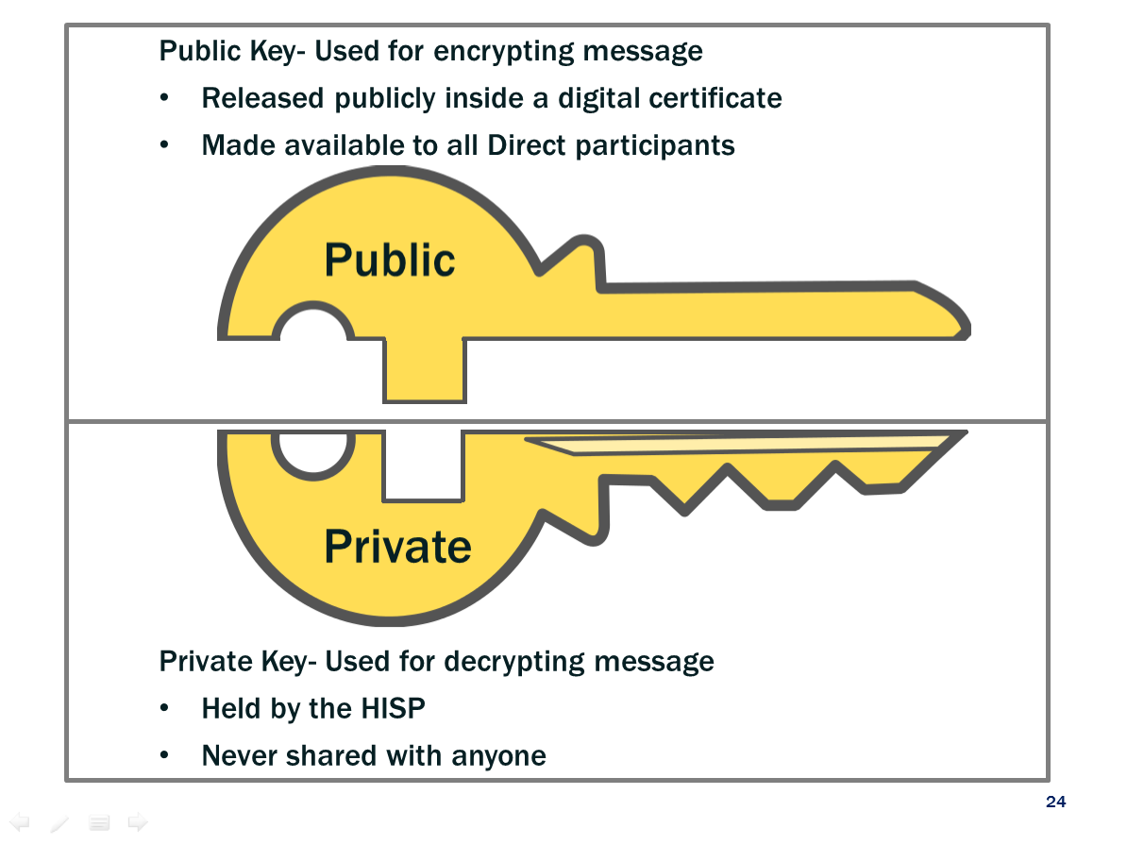
Public Key- Used for encrypting message
Released publicly inside a digital certificate
Made available to all Direct participants
Public
Private
Private Key- Used for decrypting message
Held by the HISP
Never shared with anyone

Slide 26
The sender encrypts the message with the receiver’s public key and signs the message with the sender’s private key
The message passes securely from the sender’s HISP to the receiver’s HISP
The receiver users their private key to decrypt the message and validates the sender’s signature with the sender’s public key

Slide 27
Trusted Agent Responsibilities

Slide 28
Who Should be the Trusted Agent?
Common roles of the Trusted Agent:
Human Resources
Credentialing Manager
C-level Executive
Operations
IT

Slide 29
Trusted Agent Characteristics
Characteristics of the Trusted Agent:
Loyal, trustworthy, high integrity
Employee of Provider Organization
Legally eligible to work in the US
Willing to participate in MedAllies training
Understands infrastructure and operations

Slide 30
Identity Proofing Requirements
Four Levels of Assurance defined by National Institute of Standards and Technology (NIST)
Establish confidence in user identities electronically presented to an information system
DirectTrust requires Level of Assurance 3 (LoA3) Identity Proofing
Level of Assurance 3 (LoA3): High confidence in the asserted identity’s validity

Slide 31
Who needs to be Identity Proofed?
Any individual, or End User, who has access to the MedAllies Direct Network or submits information to the MedAllies Direct Network
End Users include, but are not limited to:
Employees
Including Clinical Staff (providers), Nursing Staff, IT
Trusted Agent
Employees at Affiliated Facilities (if applicable)
Volunteer Physicians (if applicable)

Slide 32
Who needs to be Identity Proofed? (Cont’d)
Who needs to be Identity Proofed? (Cont’d)
Affiliated Facilities (If Applicable)
Trusted Agent can opt to be the Trusted Agent for other owned facilities
Single Trusted Agent would be responsible for assuring that affiliated organizations are identity proofed to same level as the Provider Organization

Slide 33
Who needs to be Identity Proofed? (Cont’d)
Volunteer Physicians (If Applicable)
Trusted Agent must ensure the following items are collected for the Volunteer Physicians:
Name
Address
Date Of Birth
Valid government issued photo ID (record the type of ID and where it was issued, ID Number and Expiration)
The Trusted Agent must also ensure the individuals are validated against the photo ID

Slide 34
The Role of the Trusted Agent is to Oversee:
Gathering Documentation
Verifying Documentation
Reporting Documentation
Maintaining Documentation

Slide 35
Gathering Documentation
Gather
Collect name, address, date of birth, and valid government issued photo ID for all Applicants (or End Users)
Verify
Report
Maintain

Slide 36
Verifying Documentation
Gather
Verification through I-9 Form
Employment Eligibility Verification Form I-9 is a U.S. Citizenship and Immigration Services form
Form I-9 complies with DirectTrust requirements for ID Proofing (LOA3)
Compare picture on government issued photo ID to End User
Verify
Report
Maintain

Slide 37
The I-9 Form
Gather
Used by employer to:
Verify employee's identity
Establish eligibility to work in U.S.
In the event of an audit:
Provider Organization must produce the I-9 Form for select individuals
Verify
Report
Maintain

Slide 38
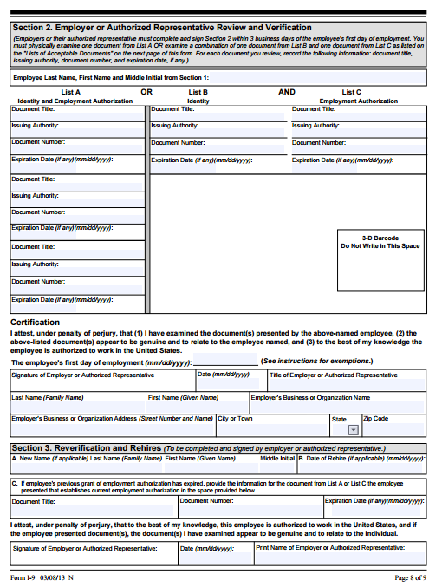
Form I-9

Slide 39
Form I-9 ID Proofing Requirements
Employee must show documentation to employer:
From either “List A” or “List B” and “List C”
List A Example*: U.S. Passport
List B Example*: Driver’s license
List C Example*: U.S. Social Security account number card
*Not limited to examples provided. Please see http://www.uscis.gov/i-9 for the most up to date version of Form I-9 and document examples.
Gather
Verify
Report
Maintain

Slide 40
Verifying Documentation
Gather
Trusted Agent’s responsibility is to ensure:
Policies and Procedures are in line with I-9 ID Proofing requirements
Proper medical staff credentialing policies and procedures are in place (DOH, JCAHO)
Verify
Report
Maintain

Slide 41
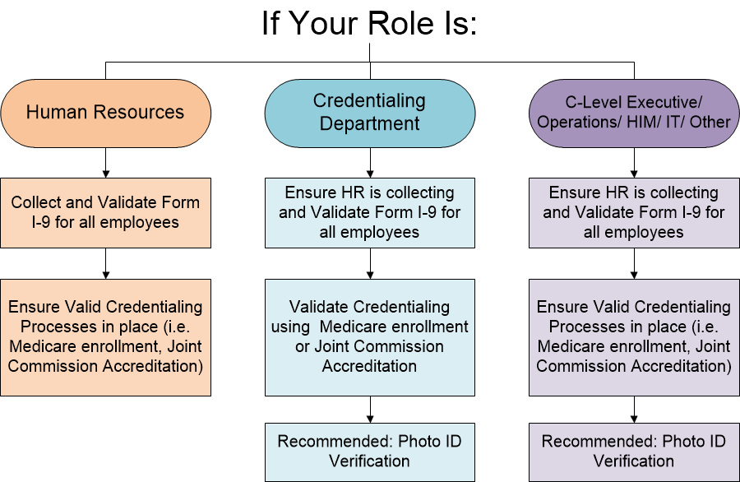
Suggested Workflows for ID Proofing:
Gather
Verify
Report
Maintain

Slide 42
Reporting Documentation
Gather
Name of verified End User sent to MedAllies before access to HISP services is provided
Must be promptly and securely sent
All information shall be accurate, current, and complete
Any changes to End User information must be promptly reported to MedAllies
This information may be extracted from your organization’s EHR or other application, if available
Validate
Report
Maintain

Slide 43
Updating End User and Trusted Agent Information
MedAllies must be promptly notified if at any point information is not accurate or current due to:
Name change
Expired visa
End User or Trusted Agent ceases to be employed by Provider Organization
Trusted Agent changes
If Trusted Agent changes:
Trusted Agent Replacement must be assigned
New Trusted Agent Addendum must be executed
Gather
Validate
Report
Maintain

Slide 44
Reporting Documentation Example
Scenario 1:
Mary Smith has changed her name to Mary Jones
IT becomes aware of this change and notifies MedAllies immediately of Mary’s name change
The Trusted Agent’s responsibility is to ensure there are processes and procedures in place to notify MedAllies in a timely manner
Gather
Validate
Report
Maintain

Slide 45
Reporting Documentation Example
Gather
Scenario 2:
The Organization has merged with another hospital and has changed its legal name from St. Joseph’s Hospital to St. Joseph’s Regional Medical Center
The Trusted Agent’s responsibility is to notify MedAllies immediately of the Organization name change and execute a new version of the Trusted Agent Addendum
Validate
Report
Maintain

Slide 46
Reporting Documentation Example
Gather
Scenario 3:
Mark Brown was the Trusted Agent for St. Joseph’s Hospital and has left the Organization
The Provider Organization:
Notifies MedAllies immediately of the Trusted Agent replacement
Executes new Trusted Agent Addendum
The Trusted Agent’s responsibility is ensure there are processes and procedures in place to notify MedAllies in a timely manner
Validate
Report
Maintain

Slide 47
Maintaining Documentation
Gather
Trusted Agent ensures the following records are maintained:
Name of the Trusted Agent or designee performing identity proofing
Date of verification
Source used to perform verification
Previously gathered documents
All records must be maintained for 7.5 years after the End User ceases to be employed by Provider Organization
Validate
Report
Maintain

Slide 48
Maintaining Documentation Example
Scenario 4:
John Smith was identity proofed in 2010 and left the Organization on March 20, 2012
The Provider Organization must maintain identity proofing documents until at least September 17, 2019
3/20/12 + 7.5 years = 9/17/19
The Trusted Agent’s responsibility is to ensure the Provider Organization’s processes are compliant with this requirement
Gather
Validate
Report
Maintain

Slide 49
Summary: Trusted Agent Oversees
Gathering Documentation
Verifying Documentation
Reporting Documentation
Maintaining Documentation
Form I-9
End User Information
7.5 Years

Slide 50
Additional Information
Changes to ID Proofing Requirements
Identity proofing requirements may change
Advance notice of these changes will be given where possible

Slide 51
Additional Information (Cont’d)
Retroactive Identity Proofing Not Required
If End Users were historically ID proofed, in accordance with the Rules*, additional identity proofing is not required
*Refer to DirectTrust Community X.509 Certificate Policy for the Rules
Notes:
Prior to the effective date of the Trusted Agent Addendum

Slide 52
Additional Information (Cont’d)
Audit
MedAllies may audit compliance to the Trusted Agent Addendum at any time
Provider Organization will provide MedAllies with access to data
Upon reasonable advance notice
MedAllies will only need to verify that I-9 documentation exists
Will not need a copy of or any information from these documents

Slide 53
Additional Information (Cont’d)
Termination of Trusted Agent Appointment
MedAllies may require the Provider Organization to terminate the appointment if:
Trusted Agent fails to comply the Trusted Agent Addendum
Security concern
i.e. Audit shows no documentation for End User on file

Slide 54
Resources
Additional Resources are made available: http://medallies.com/trustedagent.html
DirectTrust Community X.509 Certificate Policy
MedAllies Certificate Policy Statement
This Presentation
Audit information
The Trusted Agent should be familiar with these documents and should know where they can be accessed in the event of an audit.

Slide 55
Questions?
Questions can be directed to the MedAllies Support Center:
(845) 896-0191, Option 1
or supportcenter@medallies.com

